Slide 1
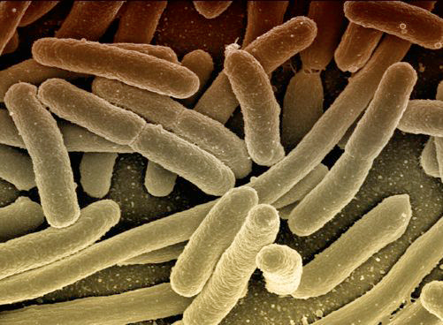
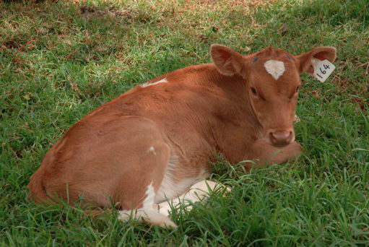
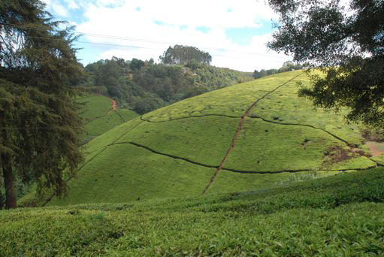
AllBio Community Building Event “Bioinformatics meets Biology” 26 June 2012

Slide 2
Programme
9:00 – 10:00 Registration and Coffee
10:00 – 10:30 AllBio – Andreas Gisel
10:30 – 13:00 4 Test Case Presentations
Patrizia Stifanelli
Stefano Castellana
Francesco Calabrese
Chrysovalentinos Pousis
13:00 – 14:00 Lunch
14:00 – 17:00 Round Table Discussion

Slide 3
ALLBIO partners
SVERIGES LANTBRUKSUNIVERSITET Sweden
Assoc. Prof. Erik Bongcam-­‐Rudloff
RADBOUD UNIVERSITY NIJMEGEN MEDICAL CENTRE Netherlands
Prof. Gert Vriend
SWISS INSTITUTE OF BIOINFORMATICS Switzerland
Dr. Laurent Falquet
THE UNIVERSITY OF MANCHESTER United Kingdom
Prof. Teresa Attwood
CONSIGLIO NAZIONALE DELLE RICERCHE Italy
Dr. Andreas Gisel
CSC - IT CENTER FOR SCIENCE Finland
Dr Eija Korpelainen
UNIVERSITÉ LIBRE DE BRUXELLES Belgium
Prof. Jacques van Helden
KAROLINSKA INSTITUTET Sweden
Prof. Thomas Svensson
UNIVERSITÄT POTSDAM and MAX PLANCK INSTITUTE FOR MOLECULAR GENETICS BERLIN Germany
Prof. Dr. Bernd Müller-Röber and Dr. Babette Regierer
EUROPEAN MOLECULAR BIOLOGY LABORATORY United Kingdom
Prof. Paul Kersey

Slide 4
ALLBIO goals
“Broadening the Bioinformatics Infrastructure to unicellular, animal, and plant science”
KBBE.2011.3.6-02: Supporting the development of Bioinformatics Infrastructures for the effective exploitation of genomic data: Beyond health applications

Slide 5
ALLBIO goals
Coordinate the generalisation and the broadening of the applicability of the many human-centric bioinformatics facilities
Coordinate the design of novel software and databases.
To structure and coordinate their collaborations with national researchers in life sciences
Design of ontologies for data and methods, and
Choosing common interoperability standards.

Slide 6
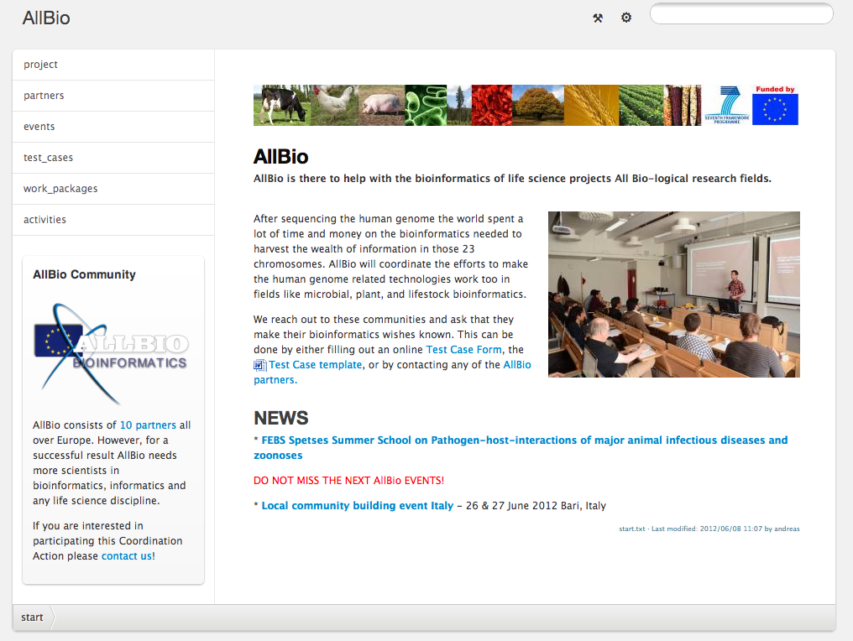
The AllBio Web Portal
http://www.allbioinformatics.eu/

Slide 7
Work Groups
WP1 Community building
The main objective of WP1 is to build a joint platform/community of life science bioinformatics developers and users to identify demands and needs for the future.
WP2 Inventory and Roadmap
The objective of WP2 is to generate a catalogue of bioinformatics tools and services that are available in the different fields of the life sciences (AllBioCatalogue)

Slide 8
Work Groups
WP3 Life Science Bioinformatics Projects The objective of the WP3 is to introduce the selected “test cases” from WP1 to the bioinformatics community and find together with them solution for these test cases.
WP4 Interoperability The main aim of the WP4 is to coordinate the process of making life science-related software packages, services and data resources work together

Slide 9
Work Groups
WP5 Validation and Training The objective of WP5 is the validation of the proposed solutions for the “test cases” generated in WP3 for different areas of the life sciences. Instruments for the extended validation processes with the target community employed for WP5 are experts’ workshops and training courses
WP6 Management Main objective of WP6 is the management of the AllBio project including the responsibility for contractual, financial, legal, and administrative issues.

Slide 10
Test Cases
AllBio will work with Test Cases the partners will define with help of external groups
Test cases will come from animal, microbiology and plant research and will describe complex bioinformatics problems.
AllBio will coordinate the solution of some Test Cases and present the solutions during dedicated events.

Slide 11
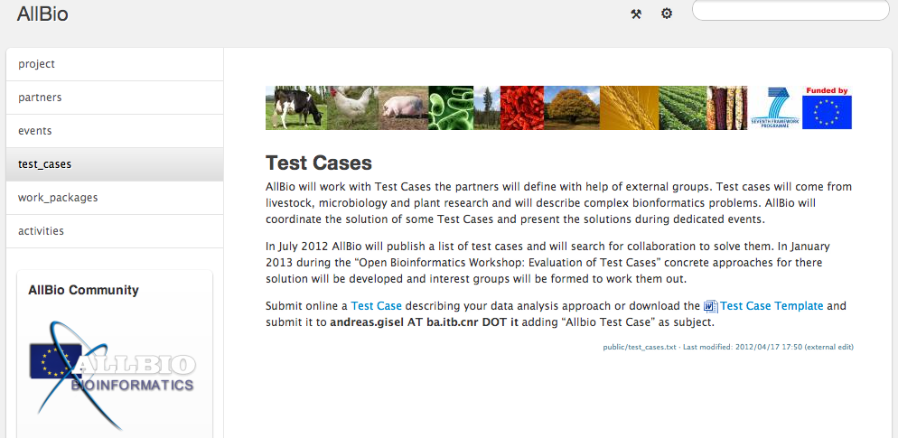
Test Cases
Submit online a Test Case describing your data analysis approach
Or work today with us to define test cases

Slide 12
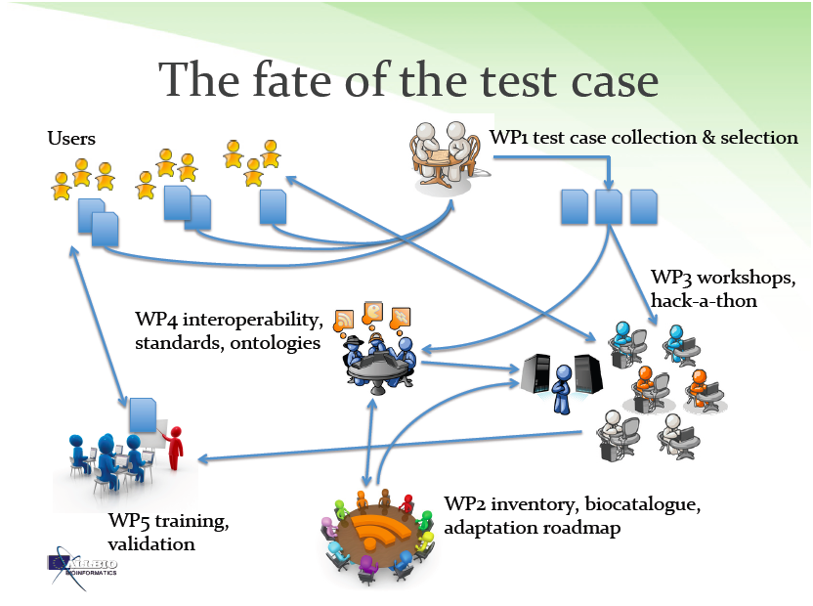

Slide 13
Benefits for you
ALLBIO works with your bioinformatics Test Cases
You will be able to participate in ALLBIO activities (Workshops, conferences, training)
ALLBIO will identify and write proposals to be able to obtain more funds for selected test cases.
You can send students to Conferences and distribute ALLBIO materials and collect Test Cases.

Slide 14
Today´s meeting
Listen and discuss possible test cases
Group discussions to fill in Test Case Templates
Identification of tools, databases and bioinformatics projects to the “AllBioCatalogue”

Slide 15
Programme
9:00 – 10:00 Registration and Coffee
10:00 – 10:30 AllBio – Andreas Gisel
10:30 – 13:00 4 Test Case Presentations
Patrizia Stifanelli
Francesca De Luca
Stefano Castellana
Francesca Calabrese
13:00 – 14:00 Lunch
14:00 – 17:00 Round Table Discussion

Slide 16
Organization Committee
Domenica D'Elia
Angelica Tulipano
Sabino Liuni
Flavio Licciulli
Giorgio Grillo
Arianna Consiglio
Nicola Losito
Domenico Catalano
Giuseppe Cananzi
Andreas Gisel

Slide 17
The Call
KBBE.2011.3.6-02: Supporting the development of Bioinformatics Infrastructures for the effective exploitation of genomic data: Beyond health applications
Bioinformatics tools for the effective exploitation of genomic data are of increasing importance across the KBBE. Recent efforts on the development of a pan-European bioinformatics infrastructure have been important but principally focused on health-related applications. It is of critical importance for maximising the utility of bioinformatics approaches for the KBBE that a balanced approach between health and non-health related applications is fostered from the earliest stages of the development of bioinformatics infrastructures. The aim of this topic is to support the KBBE bioinformatics stakeholders to coordinate, join efforts and feedback to the pan-European bioinformatics infrastructures on opportunities and priorities so to reinforce its exploitation beyond the health dimension.
Funding scheme: Coordination and support actions (coordinating action). The requested European Union contribution shall not exceed EUR 1 000 000.
Expected Impacts: It is expected that this proposal will reinforce the KBBE dimension within the pan-European bioinformatics infrastructure.

